Slide 1



GTR Shipment vs Depletion V4.0
View in Power BI
Last data refresh:
6/26/2023 7:08:35 AM UTC
Downloaded at:
6/30/2023 5:33:34 AM UTC

Slide 2
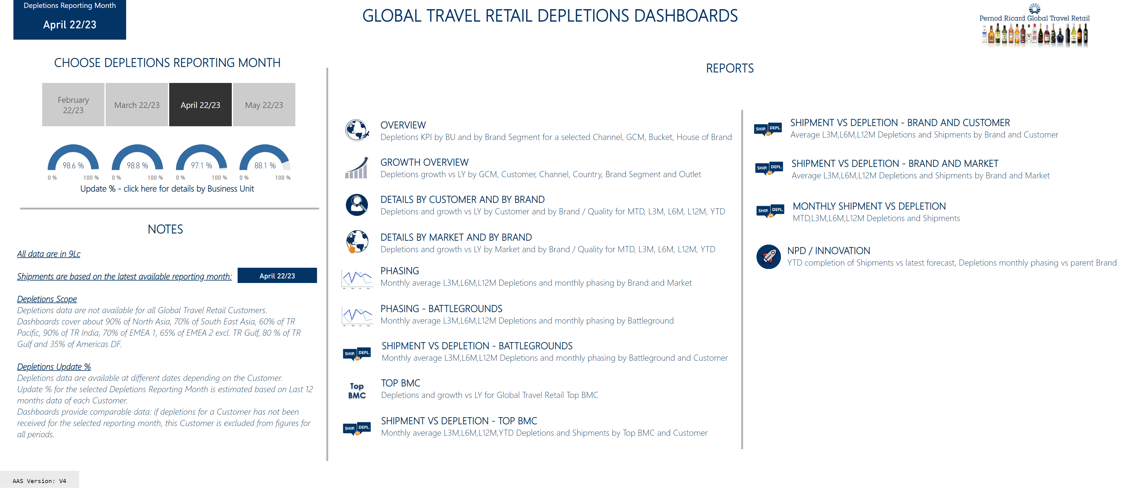
Welcome Page
Notes:
image
No alt text provided
textbox
No alt text provided
textbox
No alt text provided
textbox
No alt text provided
textbox
No alt text provided
Go !
No alt text provided
Go !
No alt text provided
textbox
No alt text provided
textbox
No alt text provided
Depletions Reporting Month
No alt text provided
Select Depletions Reporting Month
No alt text provided
gauge
No alt text provided
gauge
No alt text provided
gauge
No alt text provided
gauge
No alt text provided
textbox
No alt text provided
basicShape
No alt text provided
slicer
No alt text provided
basicShape
No alt text provided
textbox
No alt text provided
image
No alt text provided
image
No alt text provided
image
No alt text provided
image
No alt text provided
image
No alt text provided
image
No alt text provided
basicShape
No alt text provided
basicShape
No alt text provided
basicShape
No alt text provided
image
No alt text provided
textbox
No alt text provided
basicShape
No alt text provided
textbox
No alt text provided
image
No alt text provided
basicShape
No alt text provided
card
No alt text provided
% Updated
No alt text provided
% Updated
No alt text provided
% Updated
No alt text provided
% Updated
No alt text provided
basicShape
No alt text provided
Depletions Reporting Month
No alt text provided
textbox
No alt text provided
textbox
No alt text provided
textbox
No alt text provided
textbox
No alt text provided
textbox
No alt text provided
basicShape
No alt text provided
basicShape
No alt text provided
basicShape
No alt text provided
basicShape
No alt text provided
basicShape
No alt text provided
basicShape
No alt text provided
slicer
No alt text provided
textbox
No alt text provided
basicShape
No alt text provided
image
No alt text provided
textbox
No alt text provided
basicShape
No alt text provided
image
No alt text provided
textbox
No alt text provided
image
No alt text provided
textbox
No alt text provided
basicShape
No alt text provided
basicShape
No alt text provided

Slide 3
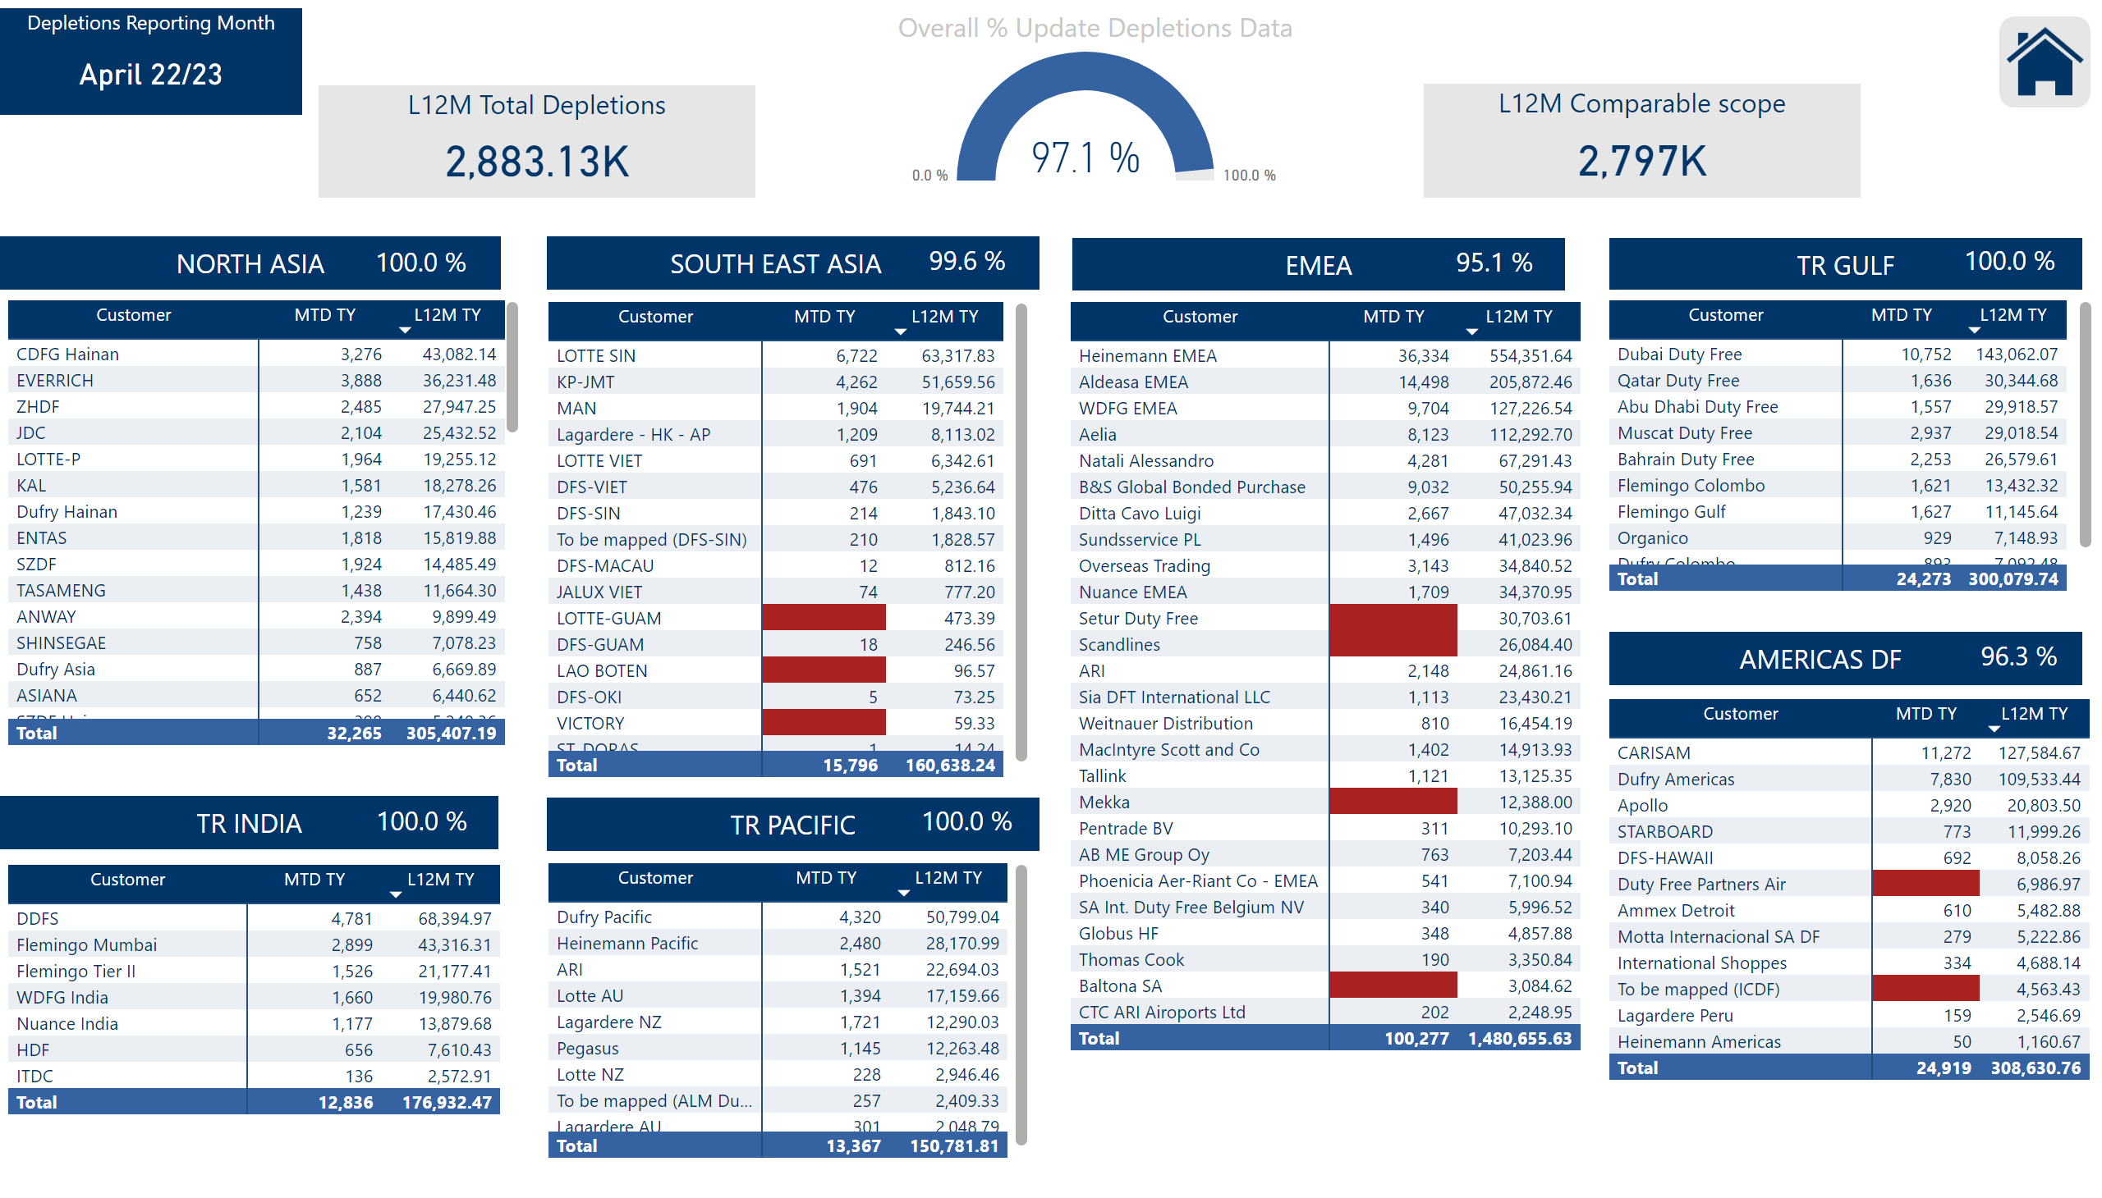
Update Status
Notes:
pivotTable
No alt text provided
textbox
No alt text provided
textbox
No alt text provided
textbox
No alt text provided
Overall % Update Depletions Data
No alt text provided
L12M Comparable scope
No alt text provided
EMEA1
No alt text provided
NA
No alt text provided
Pacific
No alt text provided
textbox
No alt text provided
SEA
No alt text provided
textbox
No alt text provided
India
No alt text provided
textbox
No alt text provided
Americas DF
No alt text provided
pivotTable
No alt text provided
pivotTable
No alt text provided
pivotTable
No alt text provided
pivotTable
No alt text provided
pivotTable
No alt text provided
textbox
No alt text provided
pivotTable
No alt text provided
slicer
No alt text provided
image
No alt text provided
slicer
No alt text provided
L12M Total Depletions
No alt text provided
EMEA - Gulf
No alt text provided
slicer
No alt text provided
Depletions Reporting Month
No alt text provided

Slide 4
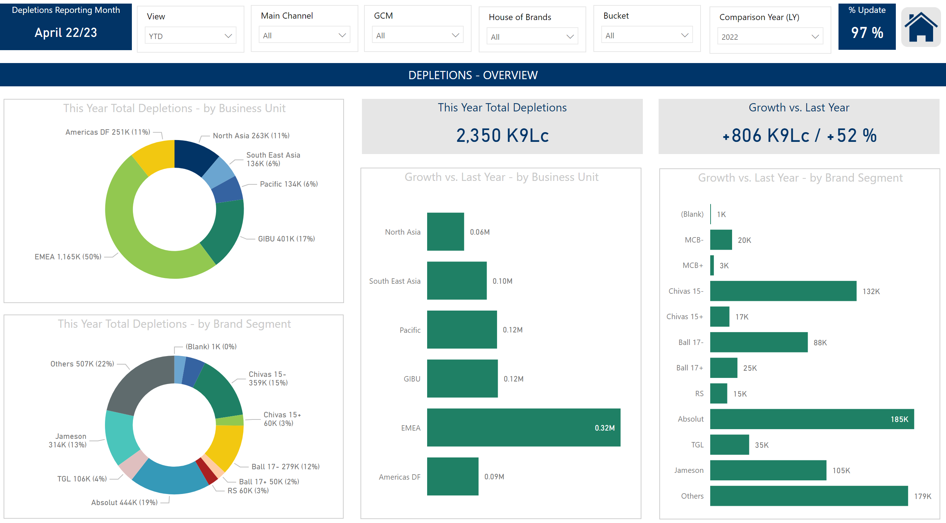
Overview
Notes:
slicer
No alt text provided
This Year Total Depletions - by Business Unit
No alt text provided
This Year Total Depletions - by Brand Segment
No alt text provided
slicer
No alt text provided
This Year Total Depletions
No alt text provided
Growth vs. Last Year
No alt text provided
slicer
No alt text provided
textbox
No alt text provided
slicer
No alt text provided
% Update
No alt text provided
Growth vs. Last Year - by Business Unit
No alt text provided
slicer
No alt text provided
image
No alt text provided
slicer
No alt text provided
slicer
No alt text provided
slicer
No alt text provided
Depletions Reporting Month
No alt text provided
Growth vs. Last Year - by Brand Segment
No alt text provided
slicer
No alt text provided

Slide 5
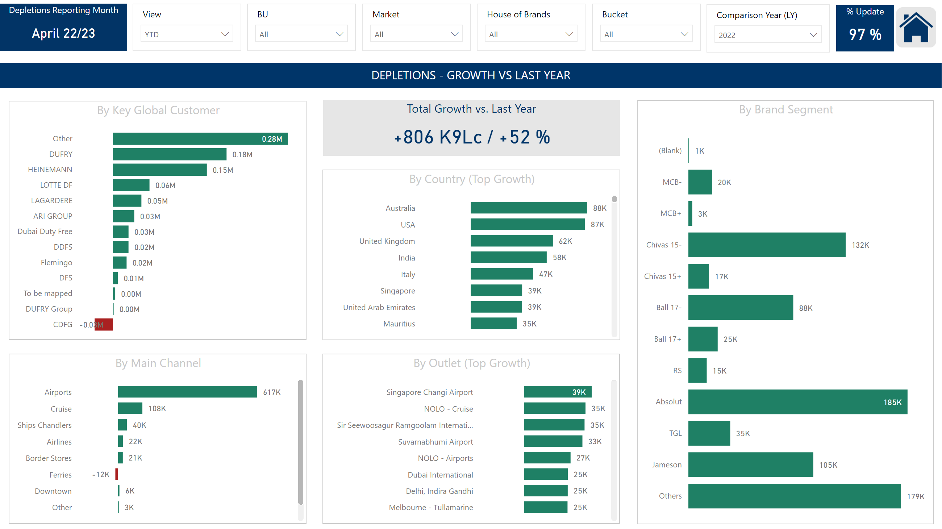
Growth Overview
Notes:
By Main Channel
No alt text provided
By Country (Top Growth)
No alt text provided
By Outlet (Top Growth)
No alt text provided
slicer
No alt text provided
slicer
No alt text provided
slicer
No alt text provided
textbox
No alt text provided
Total Growth vs. Last Year
No alt text provided
slicer
No alt text provided
% Update
No alt text provided
slicer
No alt text provided
image
No alt text provided
slicer
No alt text provided
slicer
No alt text provided
slicer
No alt text provided
Depletions Reporting Month
No alt text provided
By Key Global Customer
No alt text provided
By Brand Segment
No alt text provided
slicer
No alt text provided

Slide 6
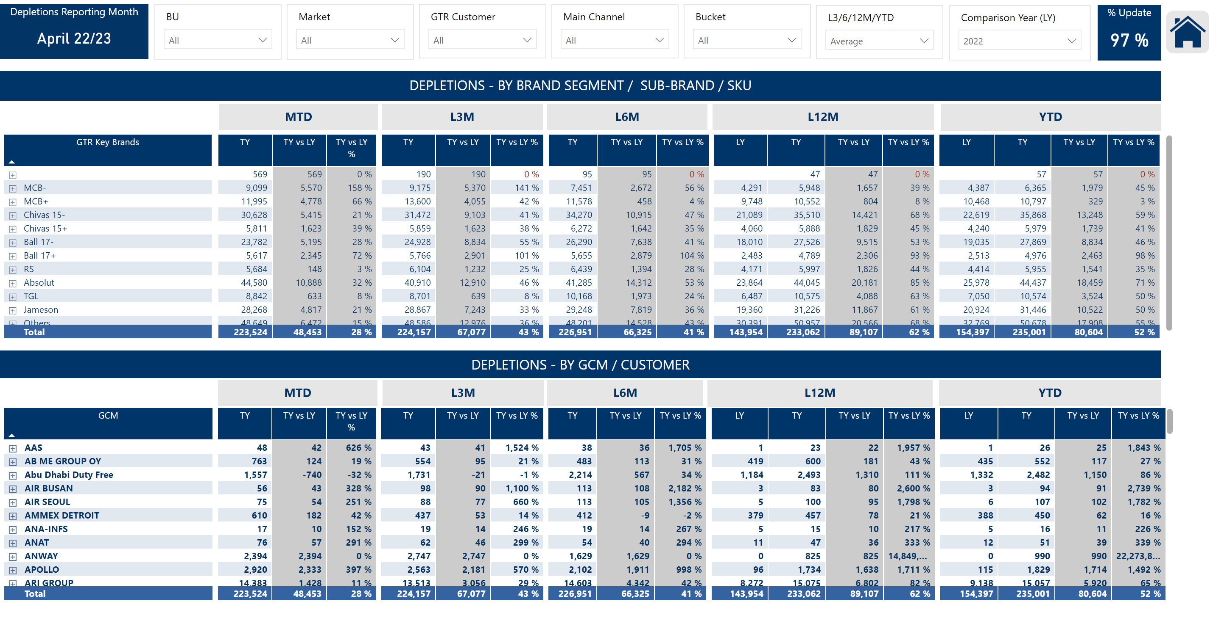
Details by Brand and by Customer
Notes:
slicer
No alt text provided
pivotTable
No alt text provided
textbox
No alt text provided
textbox
No alt text provided
textbox
No alt text provided
textbox
No alt text provided
textbox
No alt text provided
pivotTable
No alt text provided
slicer
No alt text provided
Depletions Reporting Month
No alt text provided
slicer
No alt text provided
slicer
No alt text provided
slicer
No alt text provided
slicer
No alt text provided
slicer
No alt text provided
image
No alt text provided
slicer
No alt text provided
textbox
No alt text provided
textbox
No alt text provided
textbox
No alt text provided
textbox
No alt text provided
textbox
No alt text provided
% Update
No alt text provided
textbox
No alt text provided
textbox
No alt text provided
slicer
No alt text provided
slicer
No alt text provided

Slide 7
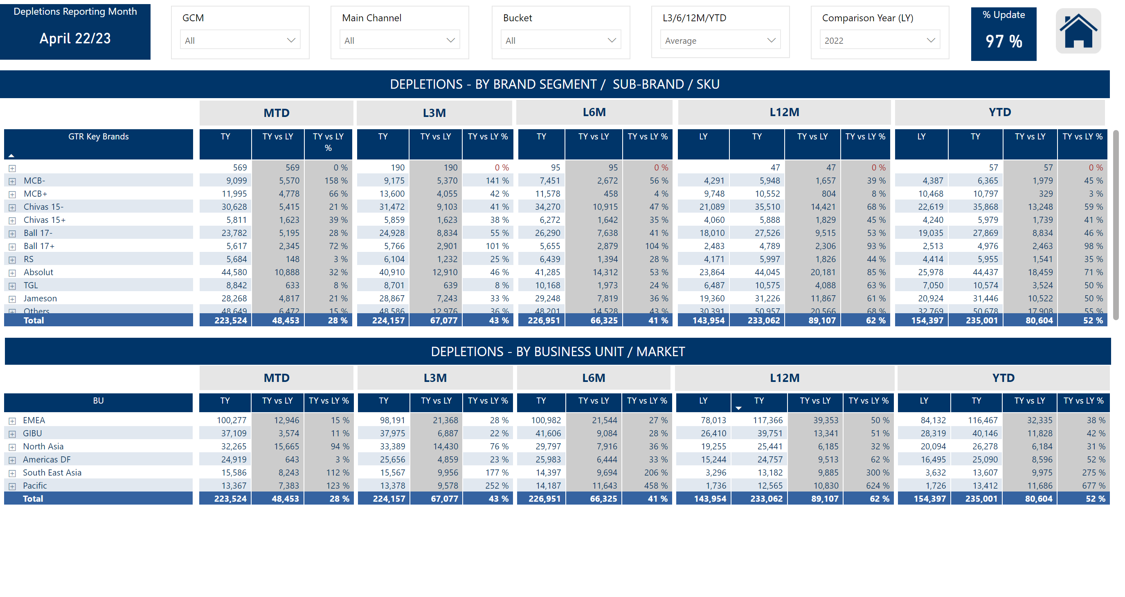
Details by Brand and by Market
Notes:
slicer
No alt text provided
slicer
No alt text provided
textbox
No alt text provided
textbox
No alt text provided
% Update
No alt text provided
slicer
No alt text provided
image
No alt text provided
slicer
No alt text provided
slicer
No alt text provided
slicer
No alt text provided
Depletions Reporting Month
No alt text provided
slicer
No alt text provided
textbox
No alt text provided
textbox
No alt text provided
textbox
No alt text provided
textbox
No alt text provided
textbox
No alt text provided
textbox
No alt text provided
textbox
No alt text provided
textbox
No alt text provided
textbox
No alt text provided
textbox
No alt text provided
pivotTable
No alt text provided
pivotTable
No alt text provided
slicer
No alt text provided

Slide 8
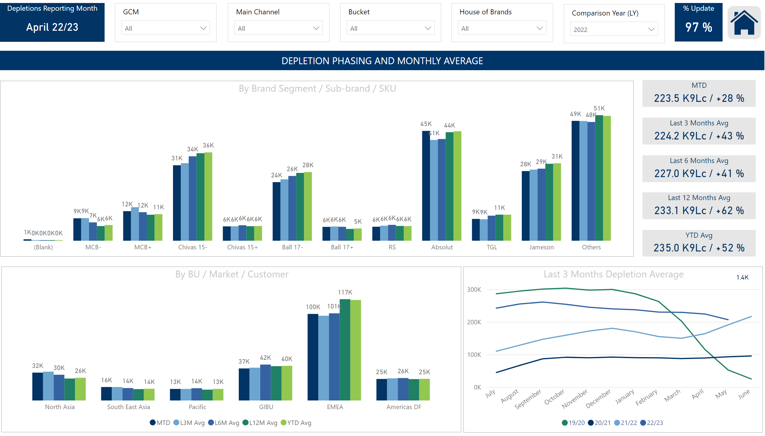
Phasing
Notes:
By BU / Market / Customer
No alt text provided
Last 3 Months Depletion Average
No alt text provided
slicer
No alt text provided
slicer
No alt text provided
textbox
No alt text provided
MTD
No alt text provided
Last 3 Months Avg
No alt text provided
Last 6 Months Avg
No alt text provided
Last 12 Months Avg
No alt text provided
slicer
No alt text provided
YTD Avg
No alt text provided
% Update
No alt text provided
slicer
No alt text provided
image
No alt text provided
slicer
No alt text provided
slicer
No alt text provided
slicer
No alt text provided
Depletions Reporting Month
No alt text provided
lineChart
No alt text provided
card
No alt text provided
By Brand Segment / Sub-brand / SKU
No alt text provided
slicer
No alt text provided
slicer
No alt text provided

Slide 9
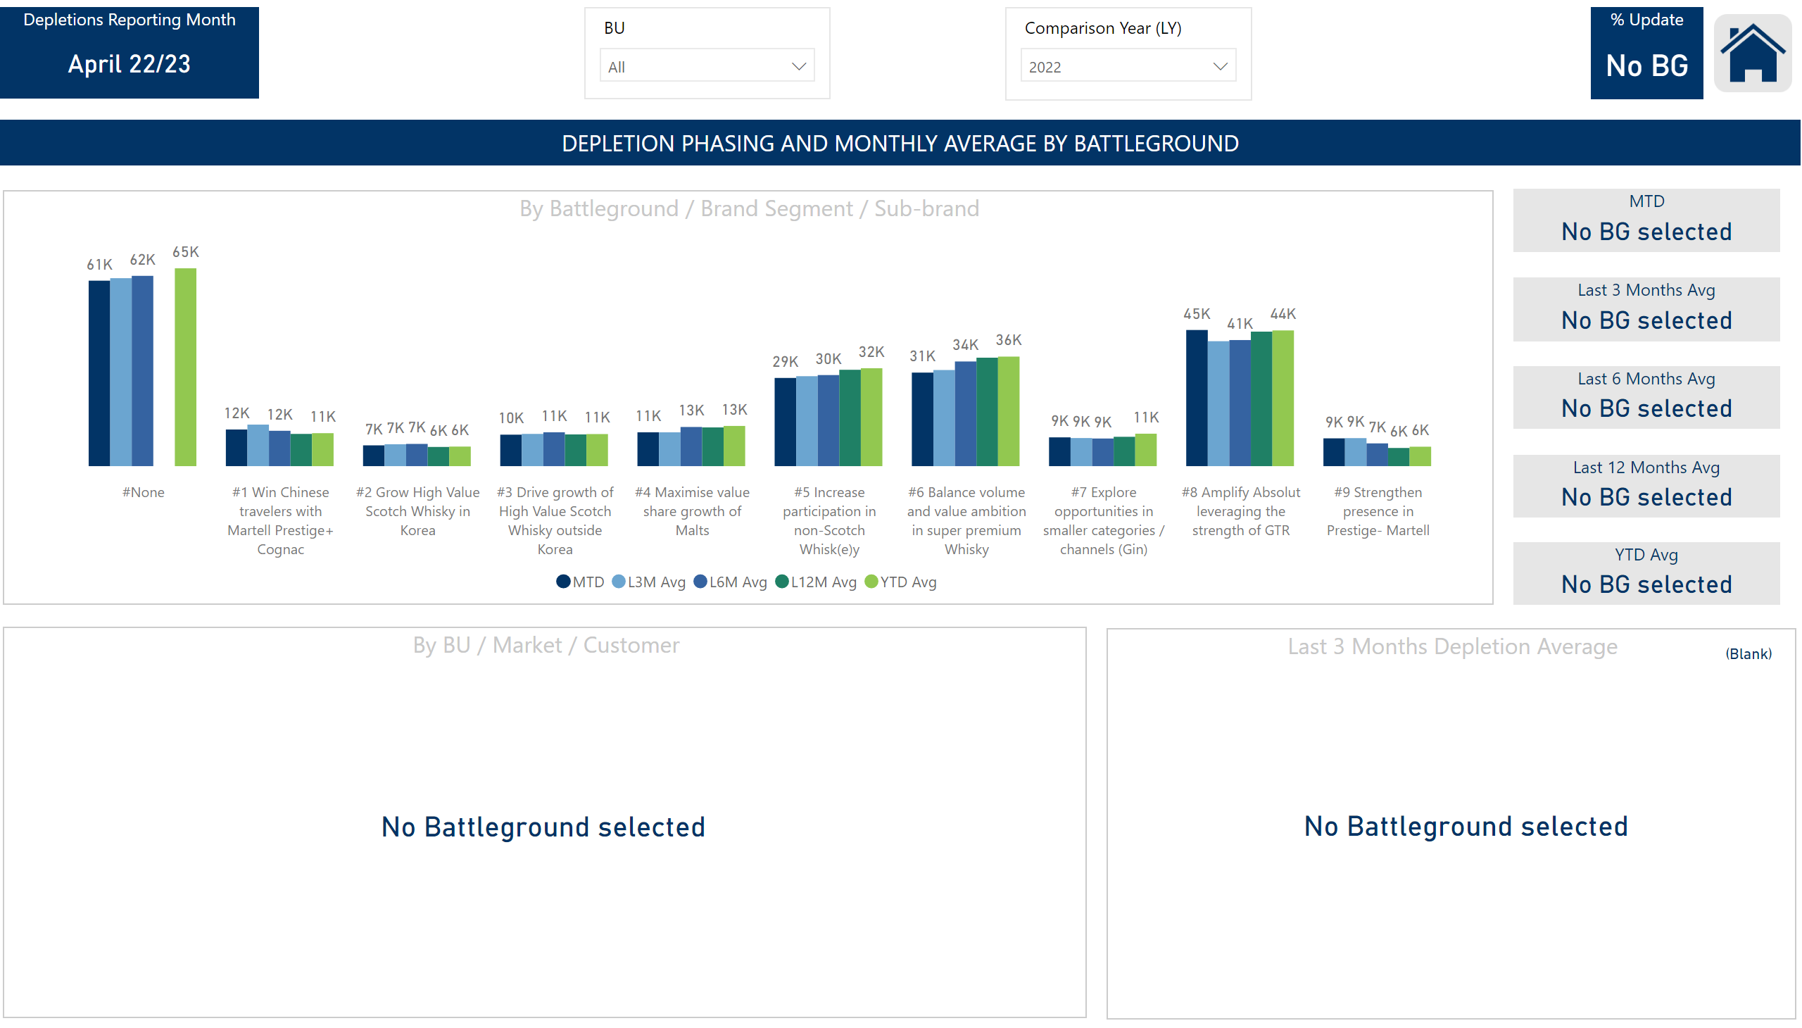
Battlegrounds Phasing
Notes:
By Battleground / Brand Segment / Sub-brand
No alt text provided
By BU / Market / Customer
No alt text provided
Last 3 Months Depletion Average
No alt text provided
slicer
No alt text provided
textbox
No alt text provided
MTD
No alt text provided
Last 3 Months Avg
No alt text provided
Last 6 Months Avg
No alt text provided
Last 12 Months Avg
No alt text provided
YTD Avg
No alt text provided
card
No alt text provided
card
No alt text provided
% Update
No alt text provided
slicer
No alt text provided
image
No alt text provided
Depletions Reporting Month
No alt text provided
slicer
No alt text provided
lineChart
No alt text provided
card
No alt text provided
slicer
No alt text provided
slicer
No alt text provided

Slide 10
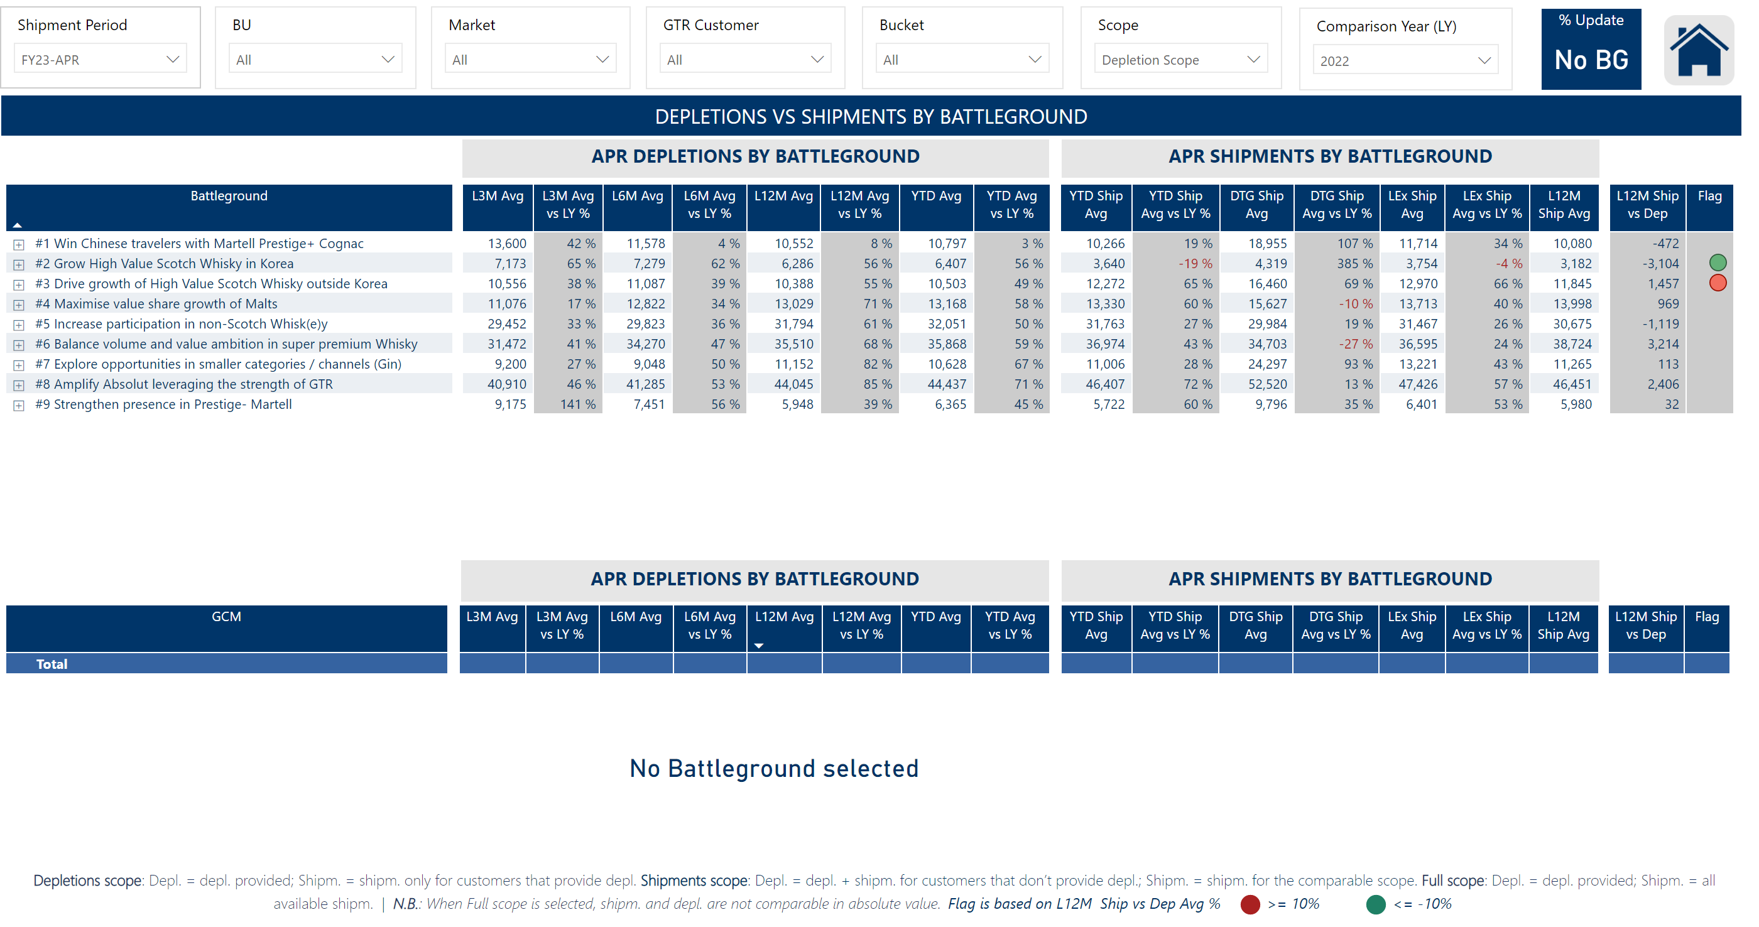
Battlegrounds Ship vs Depl
Notes:
slicer
No alt text provided
textbox
No alt text provided
pivotTable
No alt text provided
card
No alt text provided
pivotTable
No alt text provided
% Update
No alt text provided
slicer
No alt text provided
image
No alt text provided
card
No alt text provided
slicer
No alt text provided
slicer
No alt text provided
slicer
No alt text provided
slicer
No alt text provided
slicer
No alt text provided
slicer
No alt text provided
card
No alt text provided
card
No alt text provided
card
No alt text provided
textbox
No alt text provided
slicer
No alt text provided
basicShape
No alt text provided
basicShape
No alt text provided
slicer
No alt text provided

Slide 11
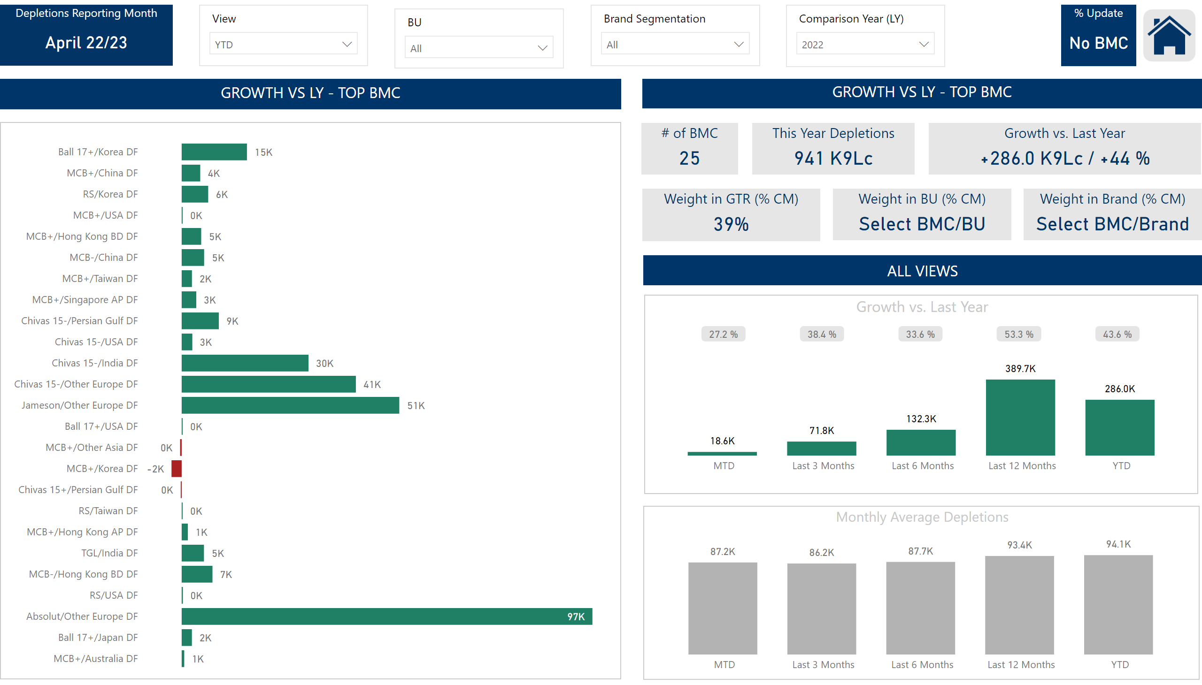
Top BMC
Notes:
slicer
No alt text provided
slicer
No alt text provided
slicer
No alt text provided
textbox
No alt text provided
Monthly Average Depletions
No alt text provided
slicer
No alt text provided
.
No alt text provided
This Year Depletions
No alt text provided
Weight in BU (% CM)
No alt text provided
Weight in GTR (% CM)
No alt text provided
Growth vs. Last Year
No alt text provided
# of BMC
No alt text provided
Weight in Brand (% CM)
No alt text provided
card
No alt text provided
Growth vs. Last Year
No alt text provided
card
No alt text provided
% Update
No alt text provided
image
No alt text provided
slicer
No alt text provided
slicer
No alt text provided
Depletions Reporting Month
No alt text provided
clusteredBarChart
No alt text provided
slicer
No alt text provided
slicer
No alt text provided

Slide 12
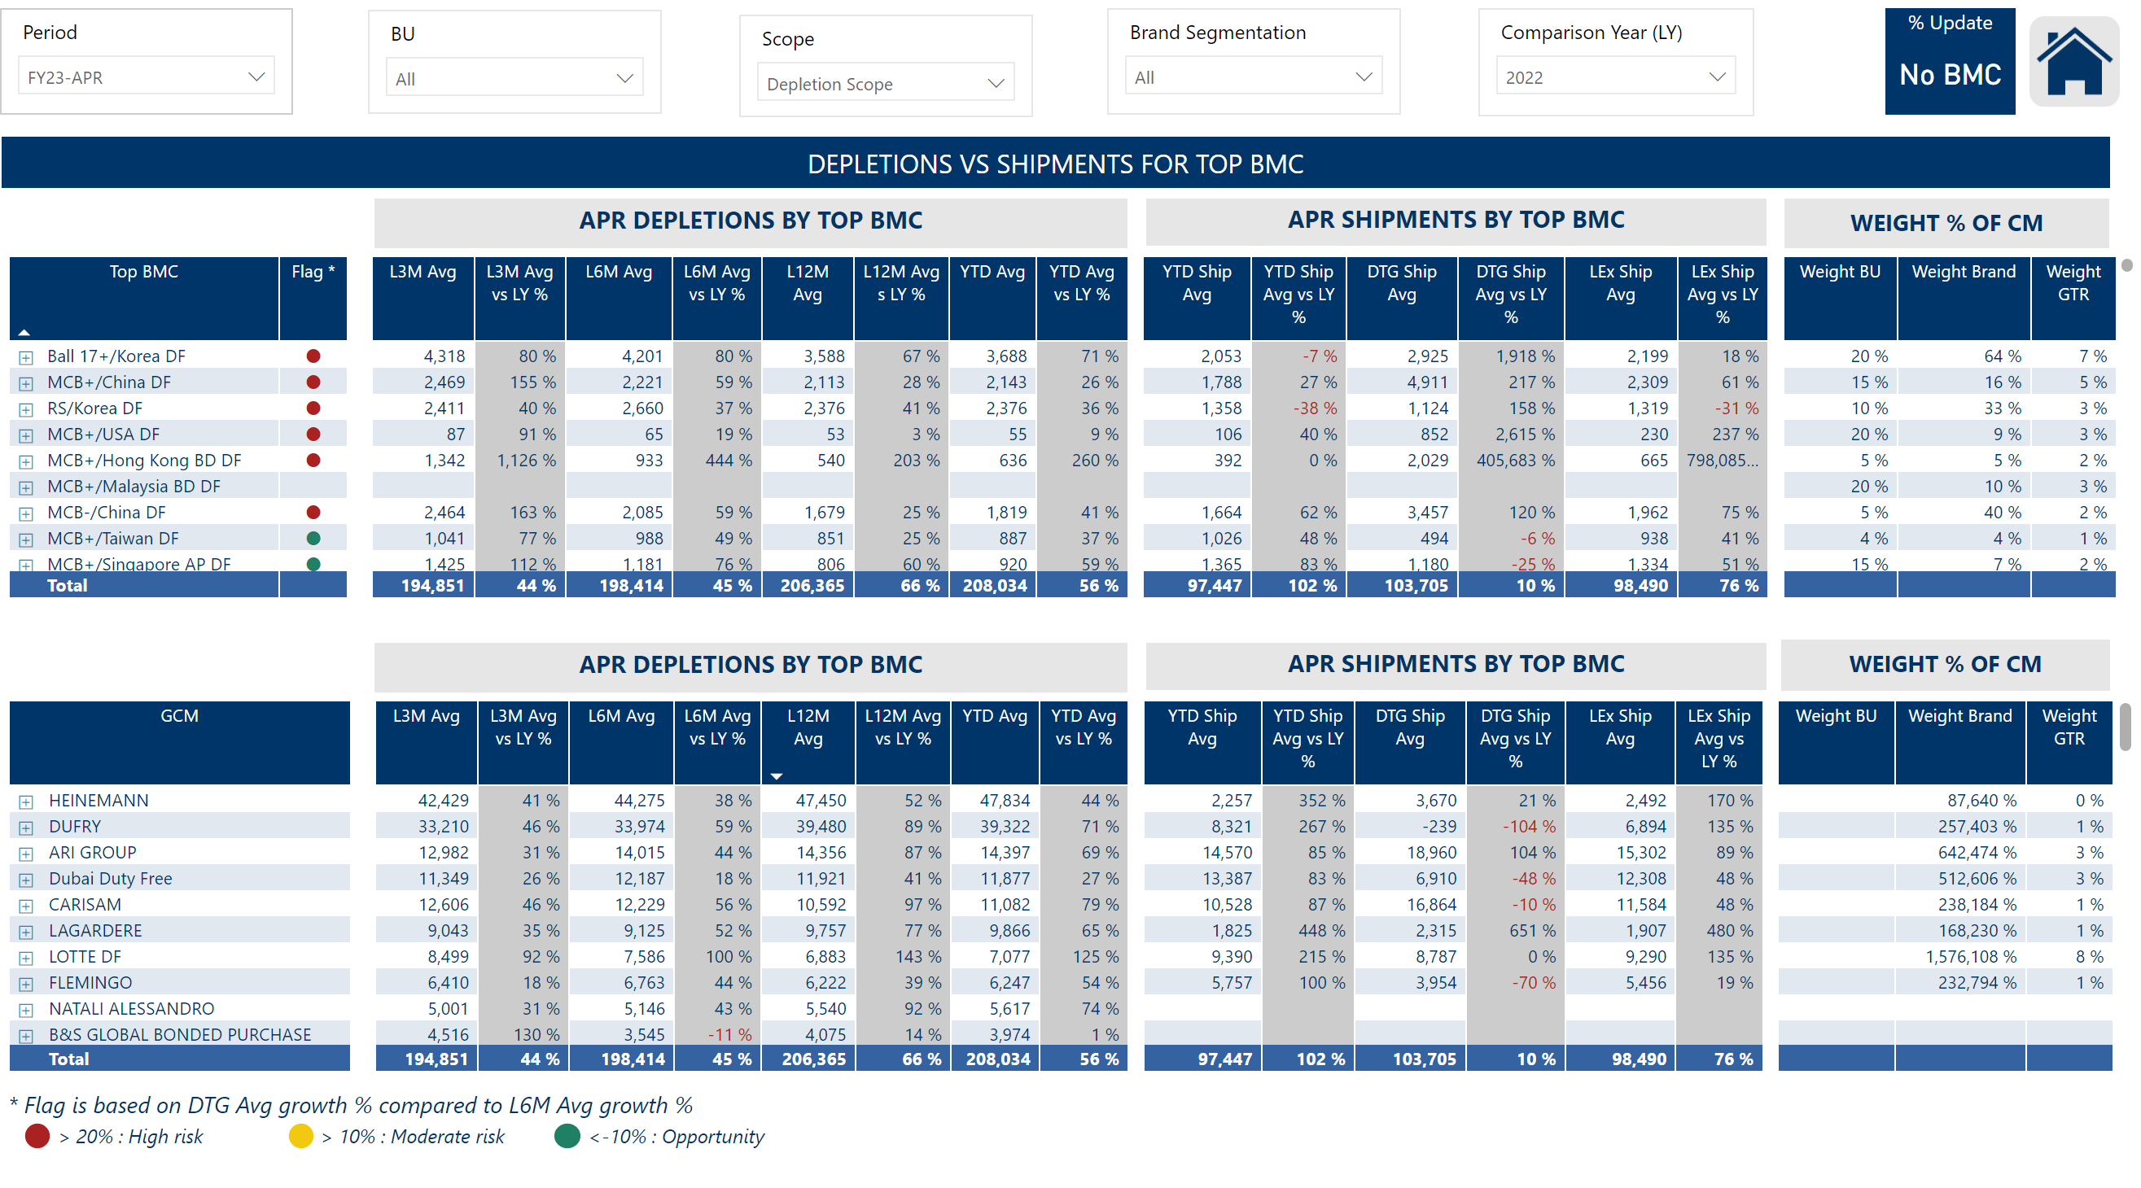
Top BMC Ship vs Depl
Notes:
slicer
No alt text provided
slicer
No alt text provided
slicer
No alt text provided
textbox
No alt text provided
pivotTable
No alt text provided
% Update
No alt text provided
textbox
No alt text provided
image
No alt text provided
card
No alt text provided
slicer
No alt text provided
pivotTable
No alt text provided
slicer
No alt text provided
textbox
No alt text provided
basicShape
No alt text provided
basicShape
No alt text provided
basicShape
No alt text provided
slicer
No alt text provided
card
No alt text provided
card
No alt text provided
card
No alt text provided
textbox
No alt text provided
slicer
No alt text provided
slicer
No alt text provided

Slide 13
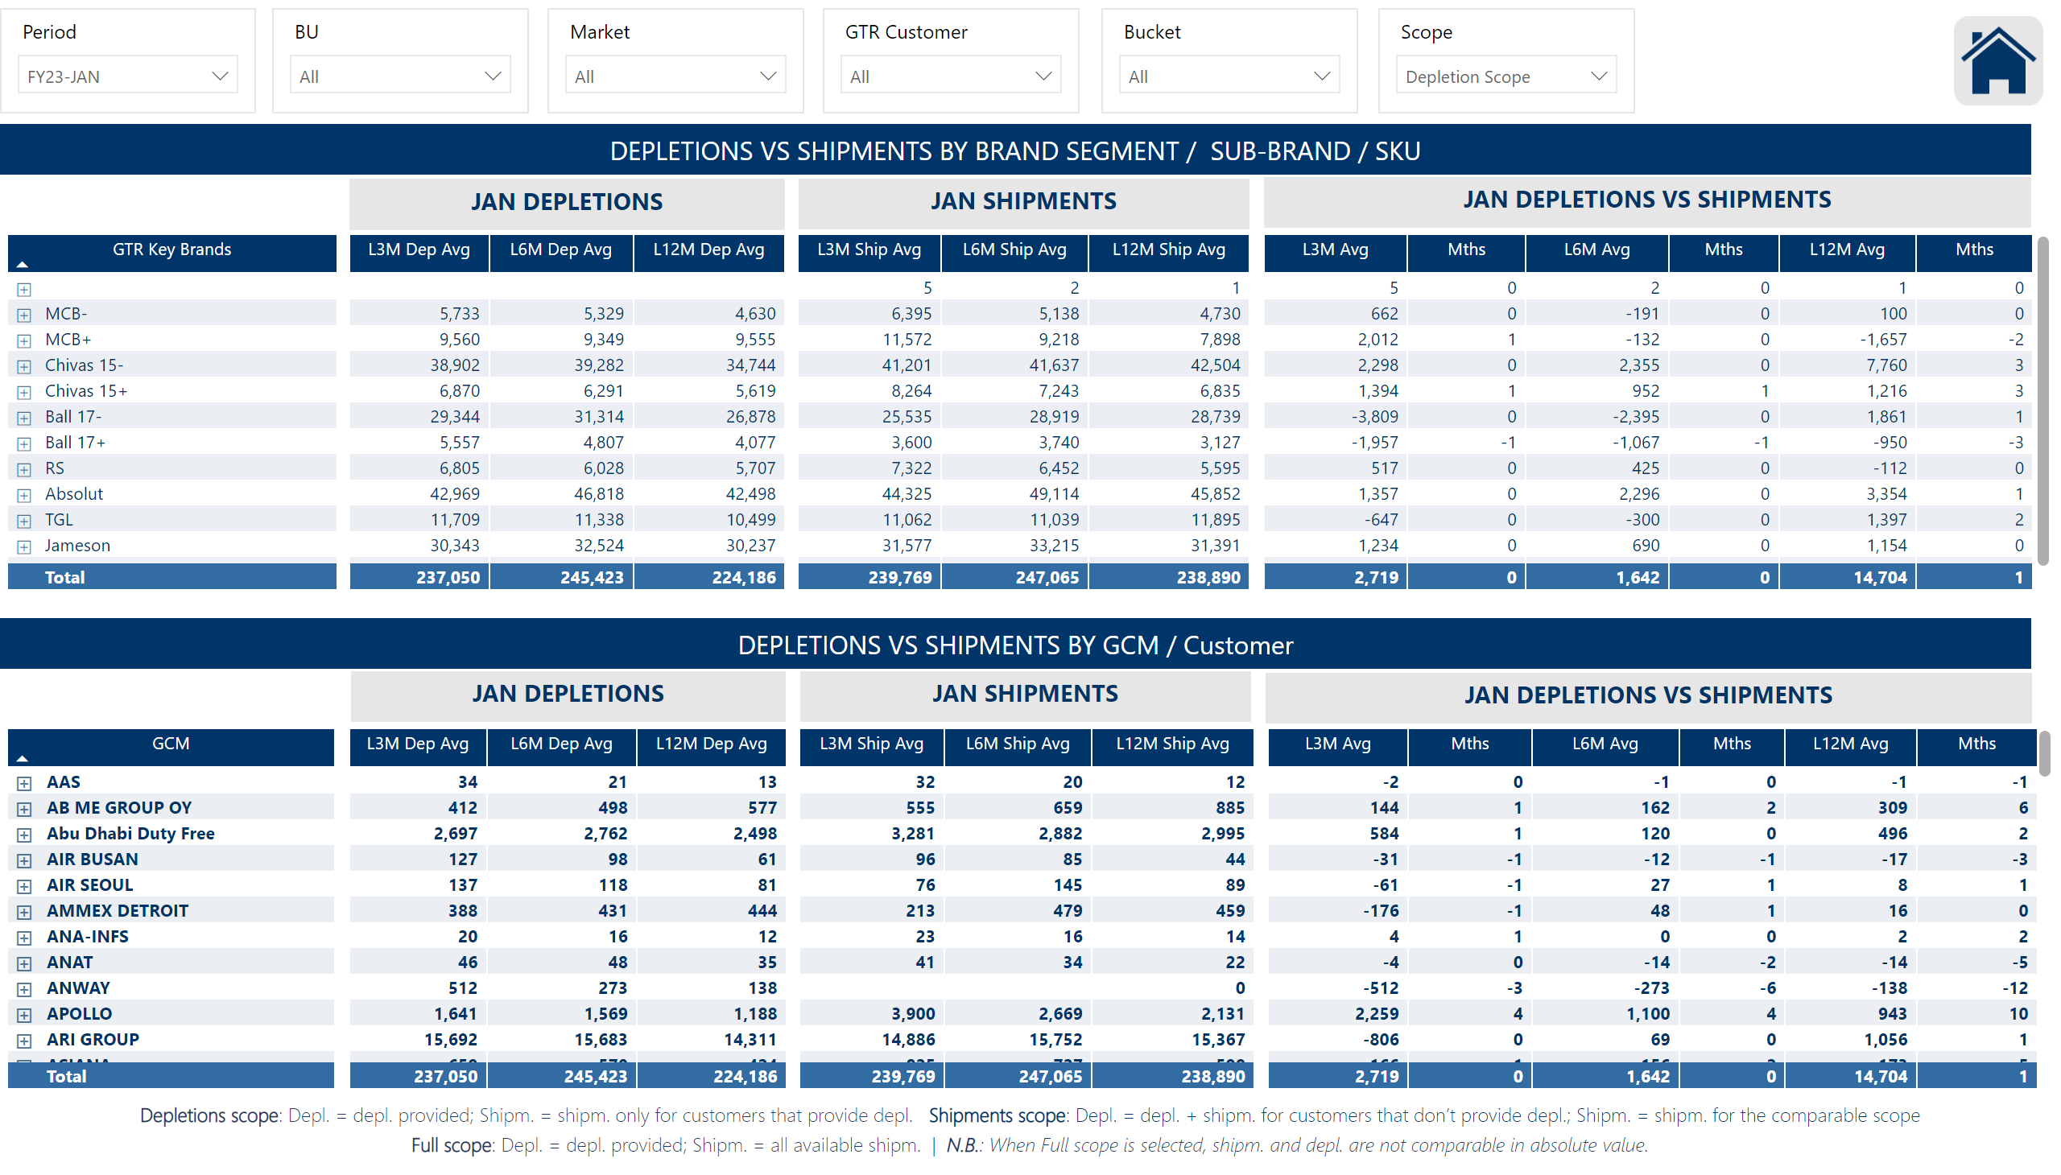
Ship vs Depl by Brand and Customer
Notes:
slicer
No alt text provided
pivotTable
No alt text provided
slicer
No alt text provided
image
No alt text provided
card
No alt text provided
slicer
No alt text provided
slicer
No alt text provided
slicer
No alt text provided
slicer
No alt text provided
slicer
No alt text provided
card
No alt text provided
card
No alt text provided
card
No alt text provided
textbox
No alt text provided
slicer
No alt text provided
pivotTable
No alt text provided
card
No alt text provided
card
No alt text provided
textbox
No alt text provided
textbox
No alt text provided
slicer
No alt text provided

Slide 14
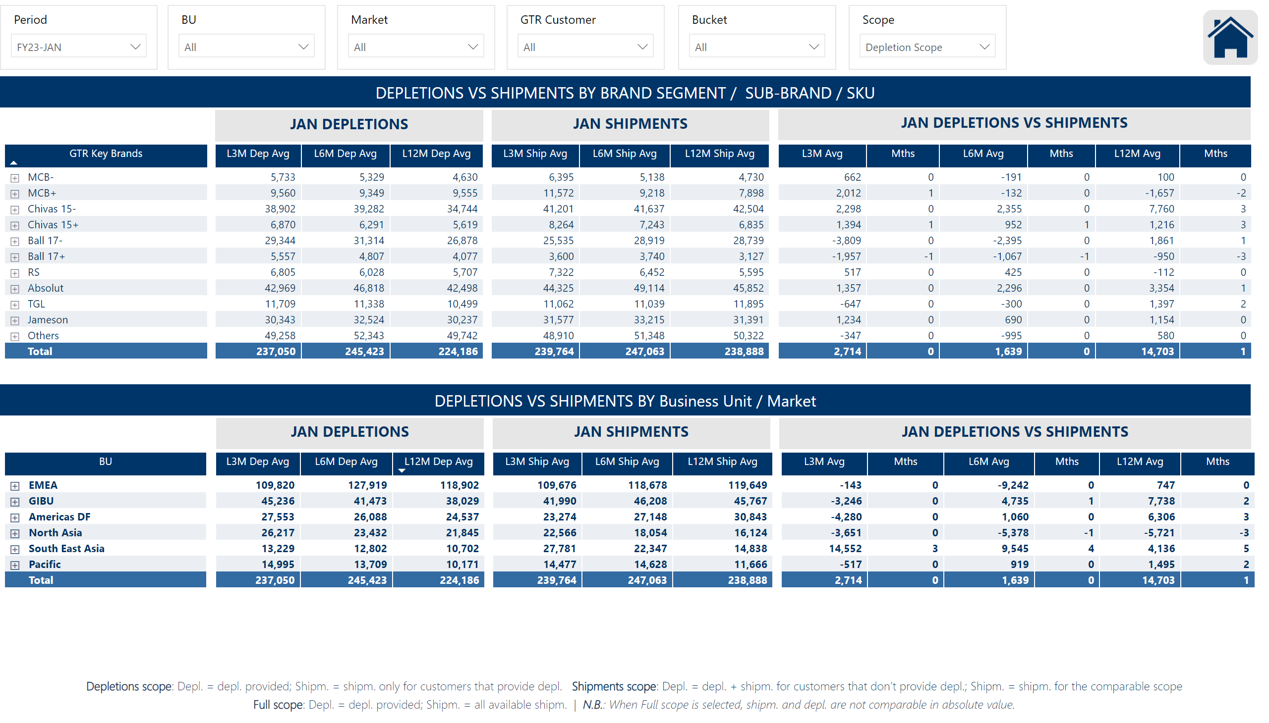
Ship vs Depl by Brand and Market
Notes:
slicer
No alt text provided
pivotTable
No alt text provided
image
No alt text provided
card
No alt text provided
slicer
No alt text provided
card
No alt text provided
card
No alt text provided
card
No alt text provided
textbox
No alt text provided
slicer
No alt text provided
pivotTable
No alt text provided
card
No alt text provided
card
No alt text provided
textbox
No alt text provided
textbox
No alt text provided
slicer
No alt text provided
slicer
No alt text provided
slicer
No alt text provided
slicer
No alt text provided
slicer
No alt text provided
slicer
No alt text provided

Slide 15
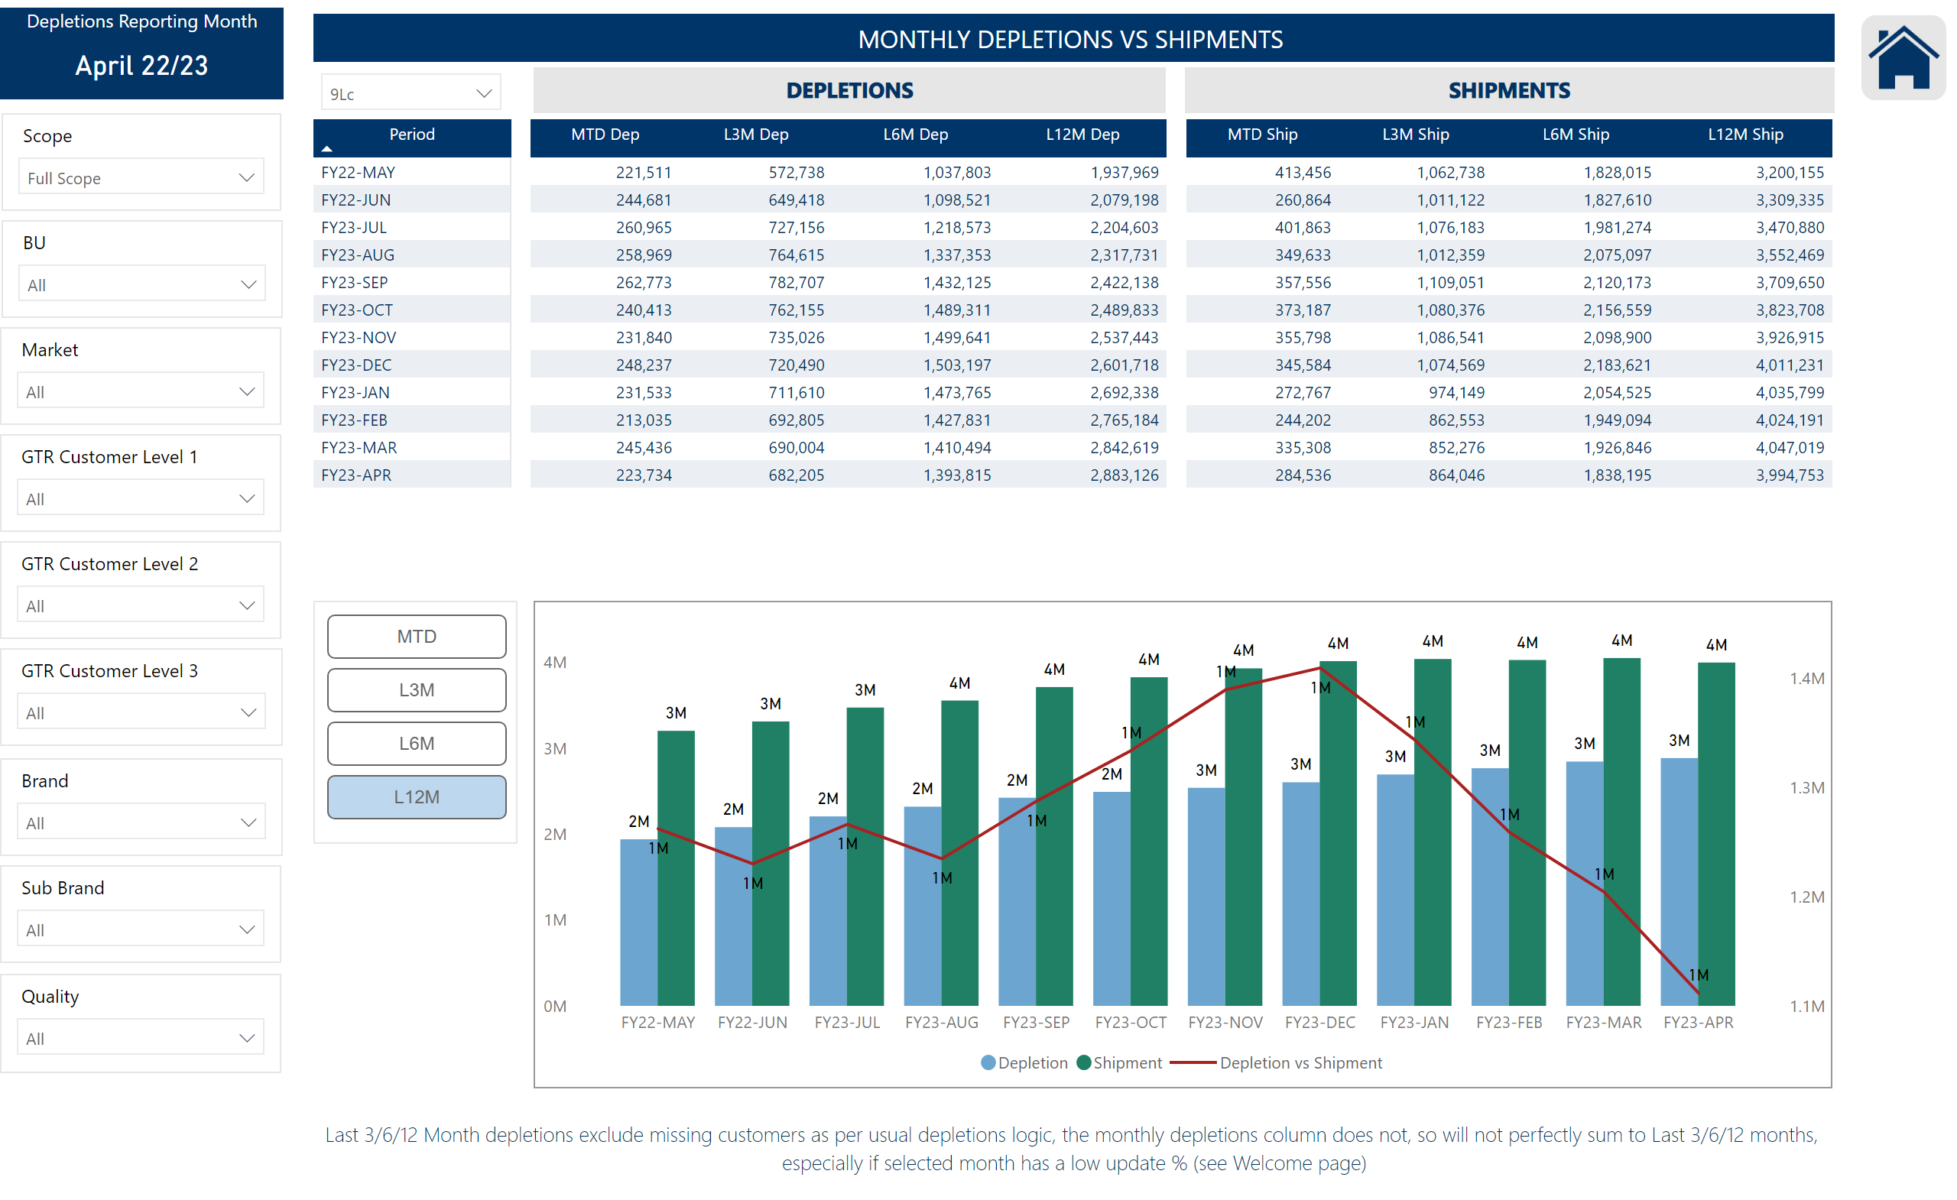
Monthly Ship vs Depl
Notes:
slicer
No alt text provided
slicer
No alt text provided
pivotTable
No alt text provided
Depletions Reporting Month
No alt text provided
slicer
No alt text provided
slicer
No alt text provided
slicer
No alt text provided
slicer
No alt text provided
slicer
No alt text provided
slicer
No alt text provided
slicer
No alt text provided
lineClusteredColumnComboChart
No alt text provided
textbox
No alt text provided
ChicletSlicer1448559807354
No alt text provided
image
No alt text provided
textbox
No alt text provided
textbox
No alt text provided
slicer
No alt text provided
slicer
No alt text provided
textbox
No alt text provided

Slide 16
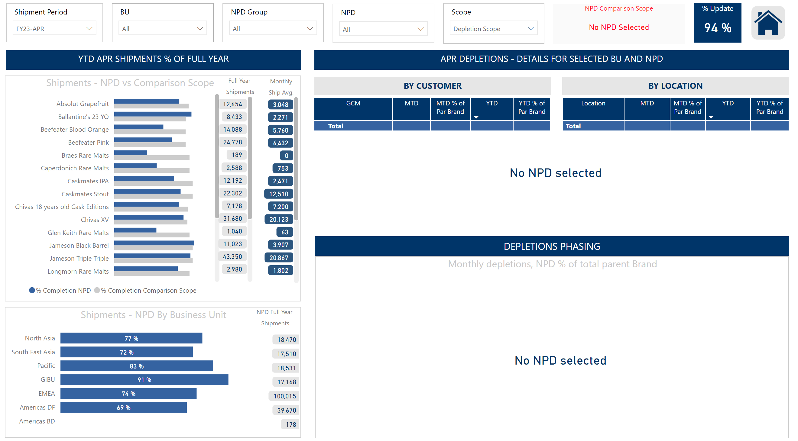
NPD
Notes:
slicer
No alt text provided
image
No alt text provided
.
No alt text provided
slicer
No alt text provided
Monthly depletions, NPD % of total parent Brand
No alt text provided
card
No alt text provided
slicer
No alt text provided
Shipments - NPD vs Comparison Scope
No alt text provided
.
No alt text provided
Shipments - NPD By Business Unit
No alt text provided
pivotTable
No alt text provided
textbox
No alt text provided
textbox
No alt text provided
card
No alt text provided
textbox
No alt text provided
textbox
No alt text provided
textbox
No alt text provided
card
No alt text provided
card
No alt text provided
pivotTable
No alt text provided
slicer
No alt text provided
NPD Comparison Scope
No alt text provided
% Update
No alt text provided
slicer
No alt text provided
slicer
No alt text provided
a
No alt text provided
aaaa
No alt text provided
textbox
No alt text provided
slicer
No alt text provided

